Slide 1

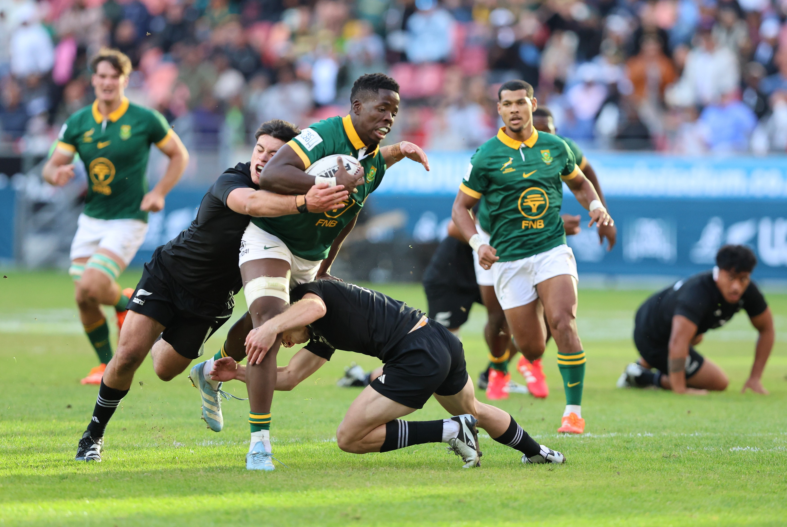
Junior Springboks
Media Guide
World Rugby U20s Italy 2025

Slide 2
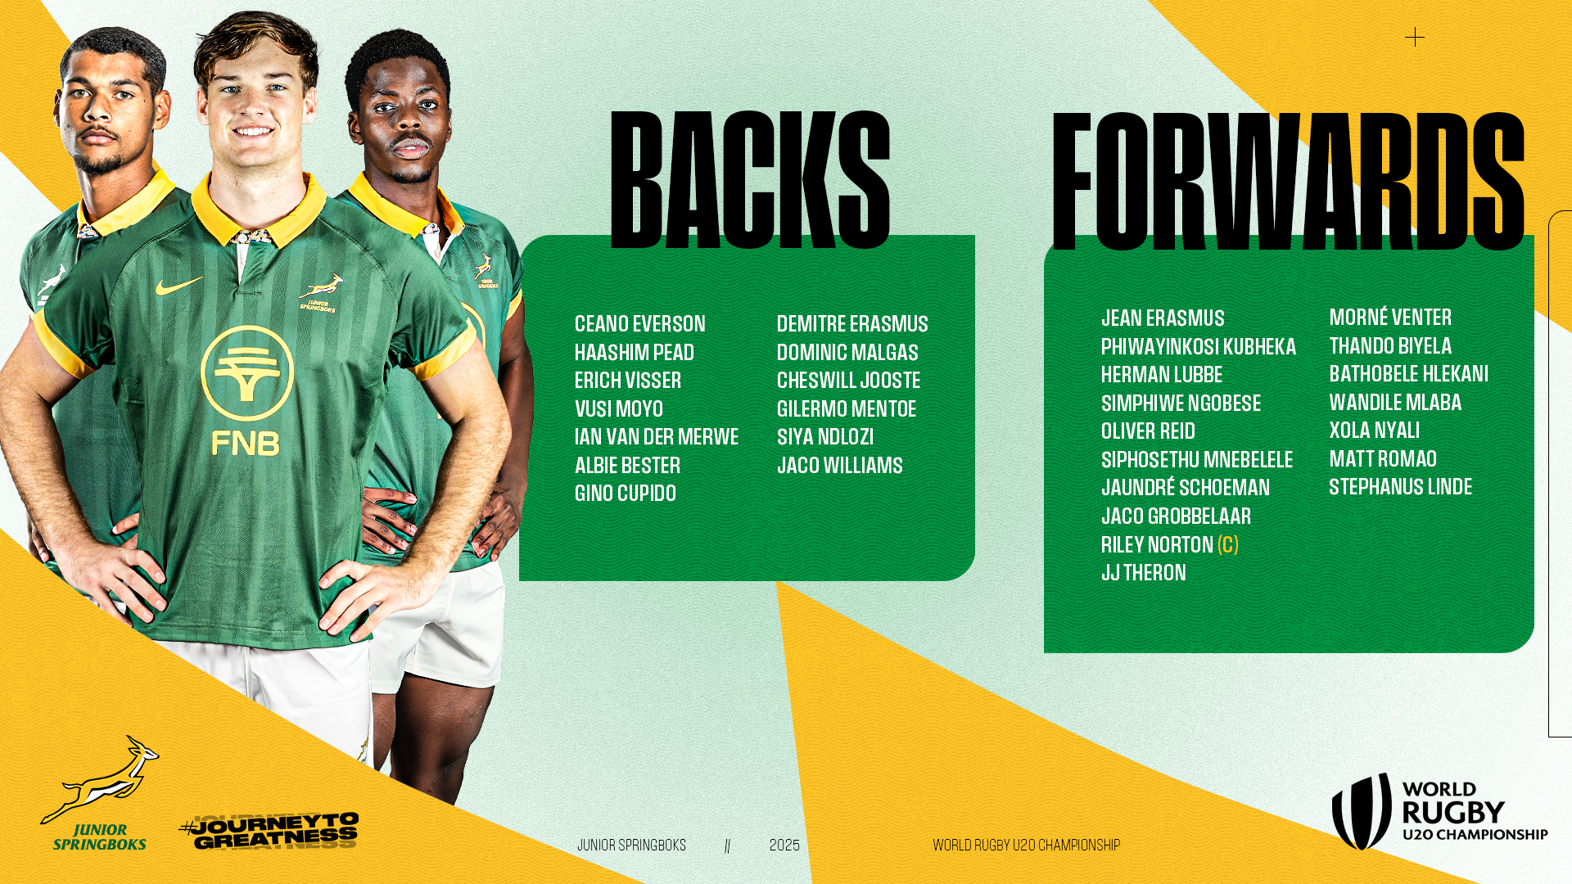

Slide 3
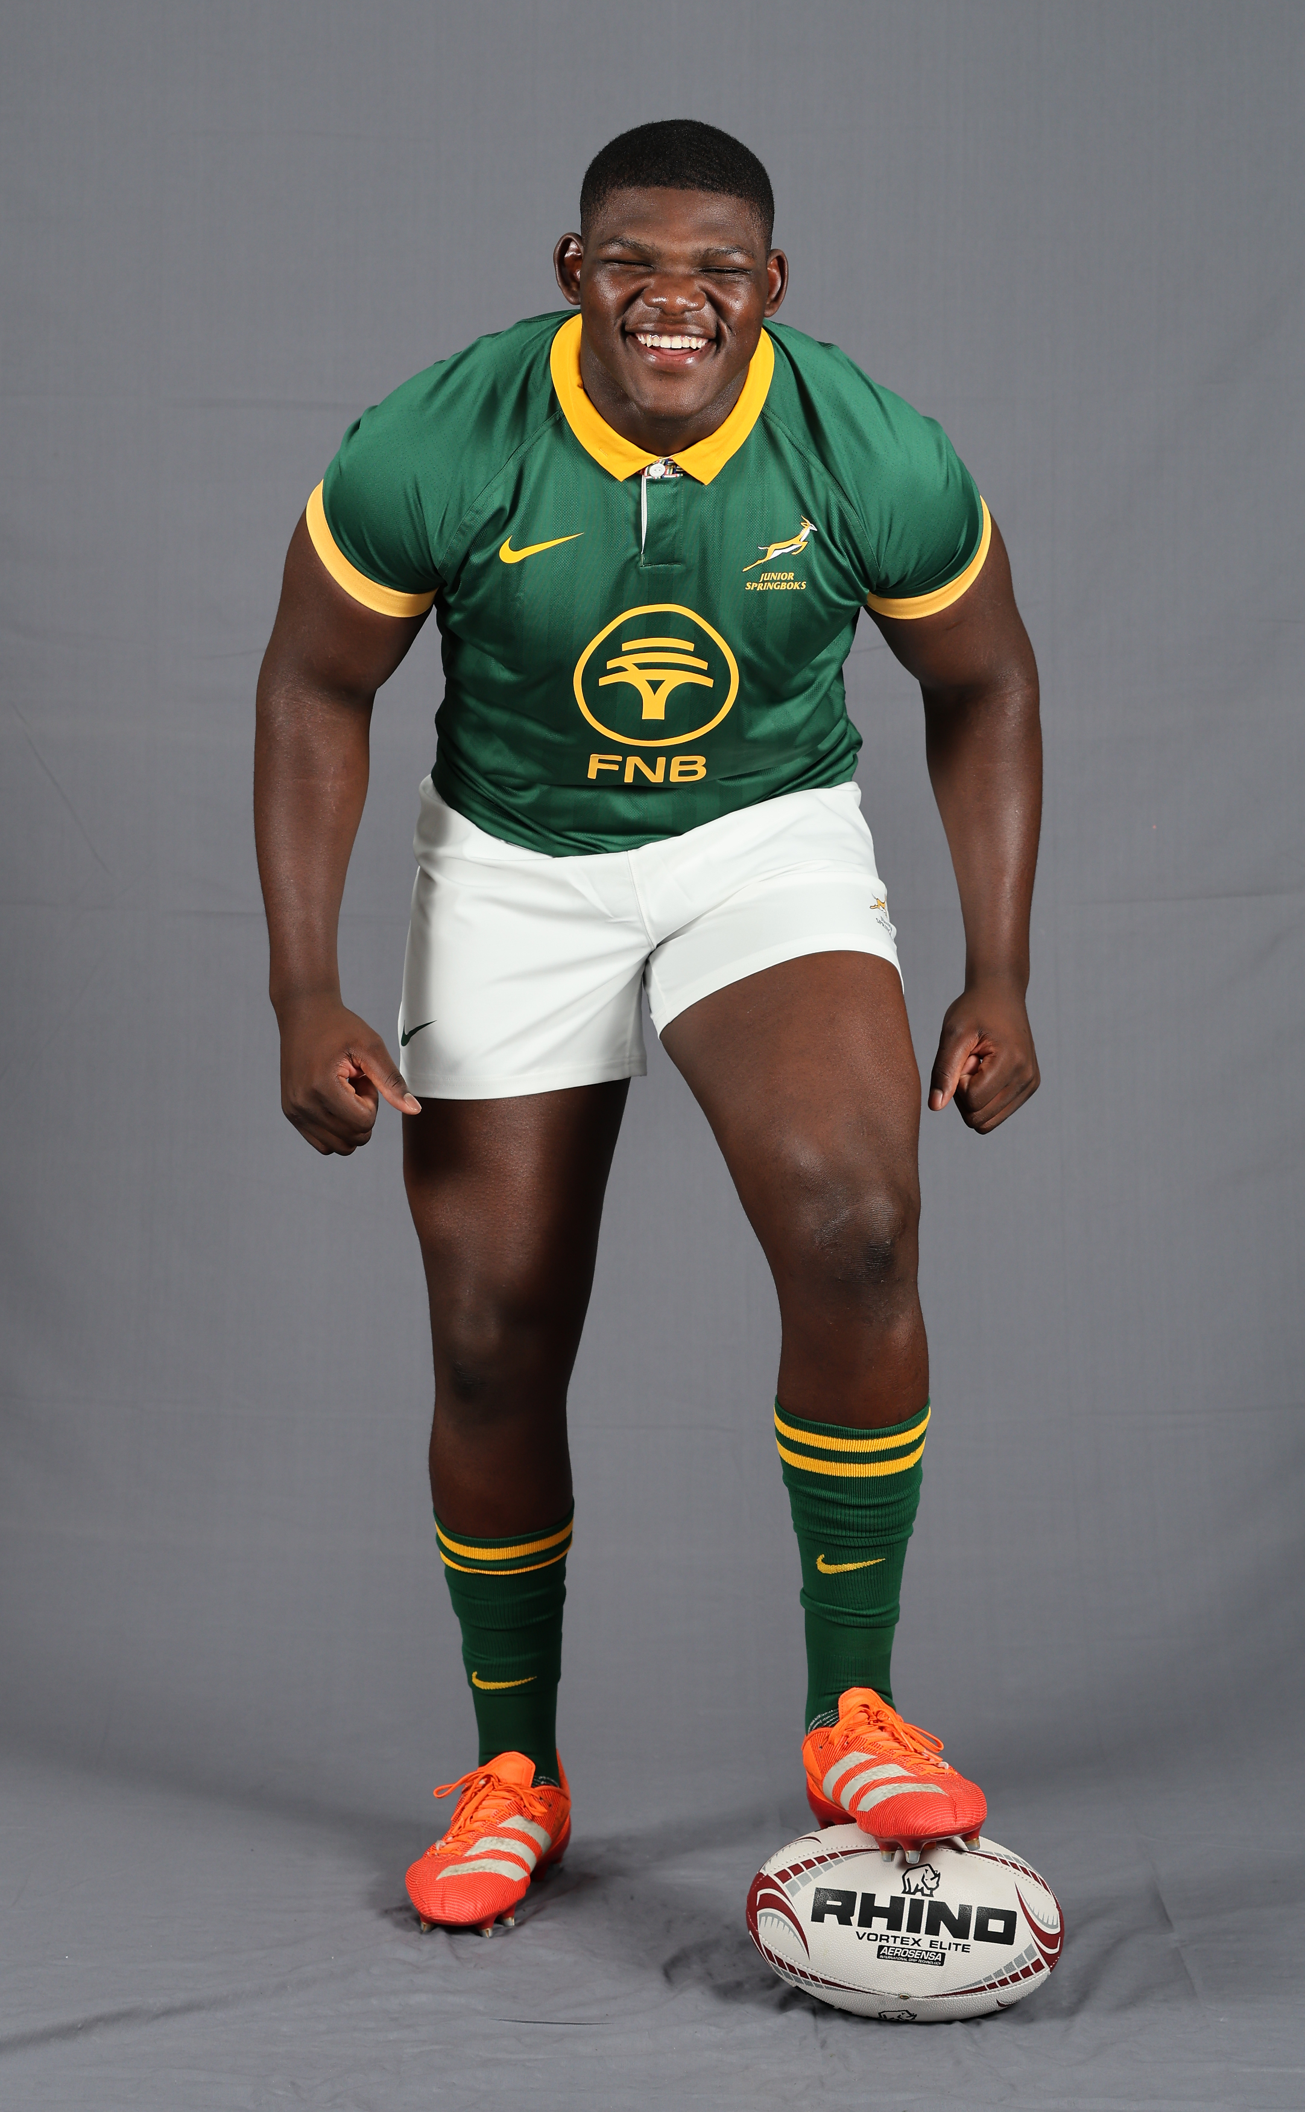
Player Profiles

Slide 4
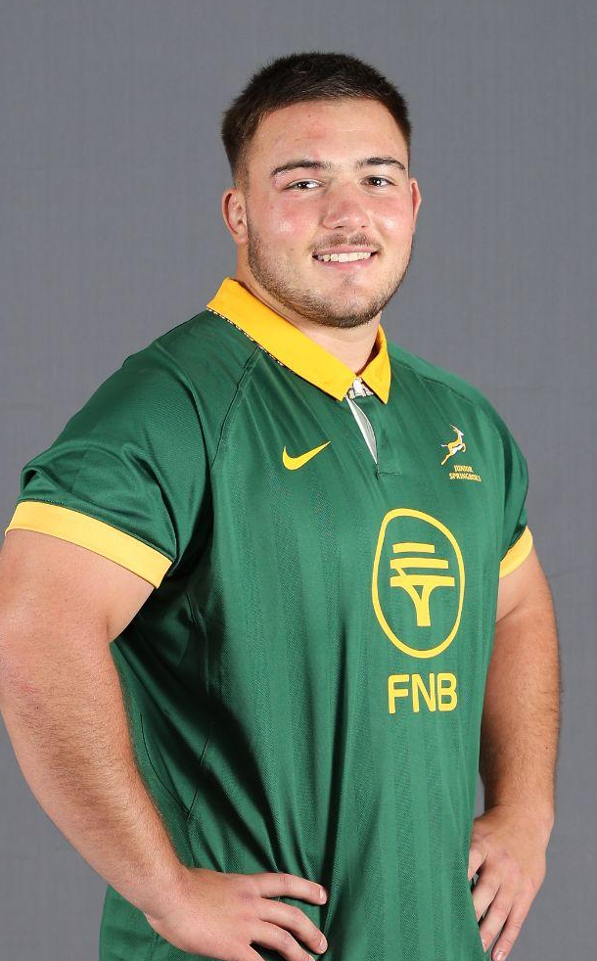
JEAN
ERASMUS
VODACOM BULLS
POSITION - PROP
1.88m
HEIGHT
100KG
WEIGHT

Slide 5
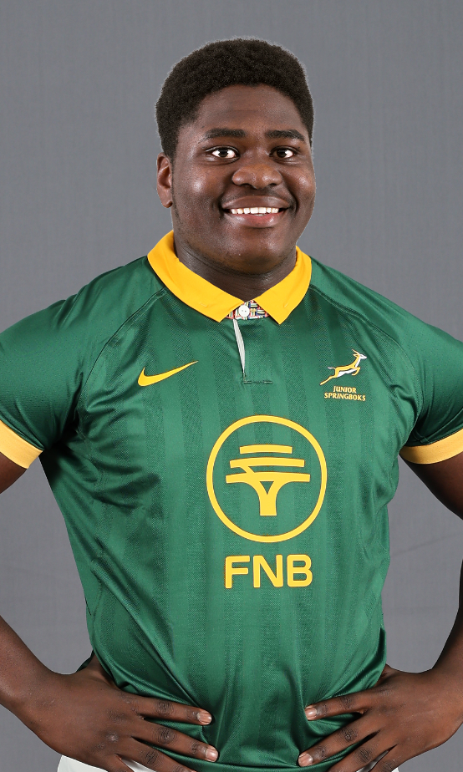
PHIWAYINKKOSI
KUBHEKA
HOLLYWOODBETS SHARKS
POSITION - PROP
1.78m
HEIGHT
120KG
WEIGHT

Slide 6
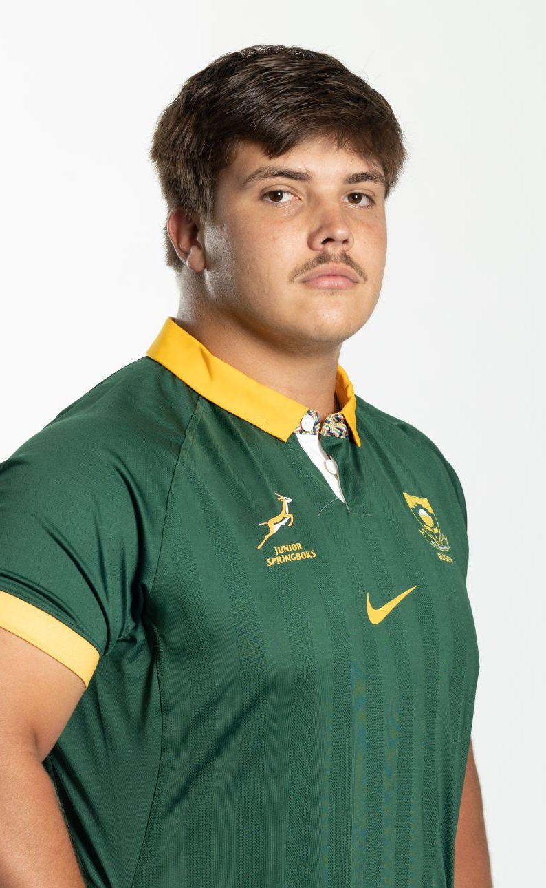
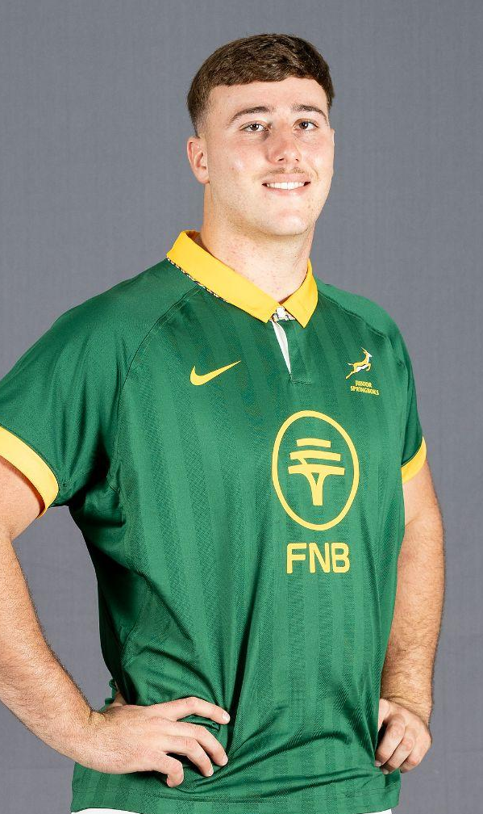
HERMAN
LUBBE
DHL WESTERN PROVINCE
POSITION - PROP
1.90m
HEIGHT
120KG
WEIGHT

Slide 7
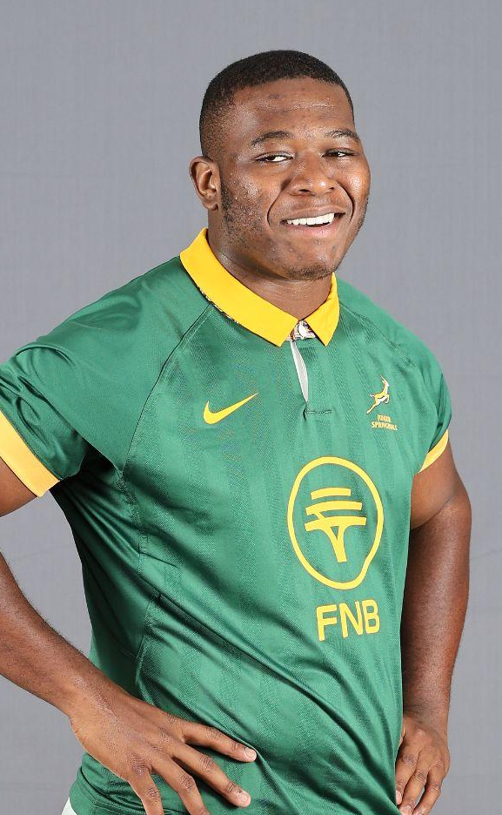
SIMPHIWE
NGOBESE
HOLLYWOODBETS SHARKS
POSITION - PROP
1.83m
HEIGHT
119KG
WEIGHT

Slide 8
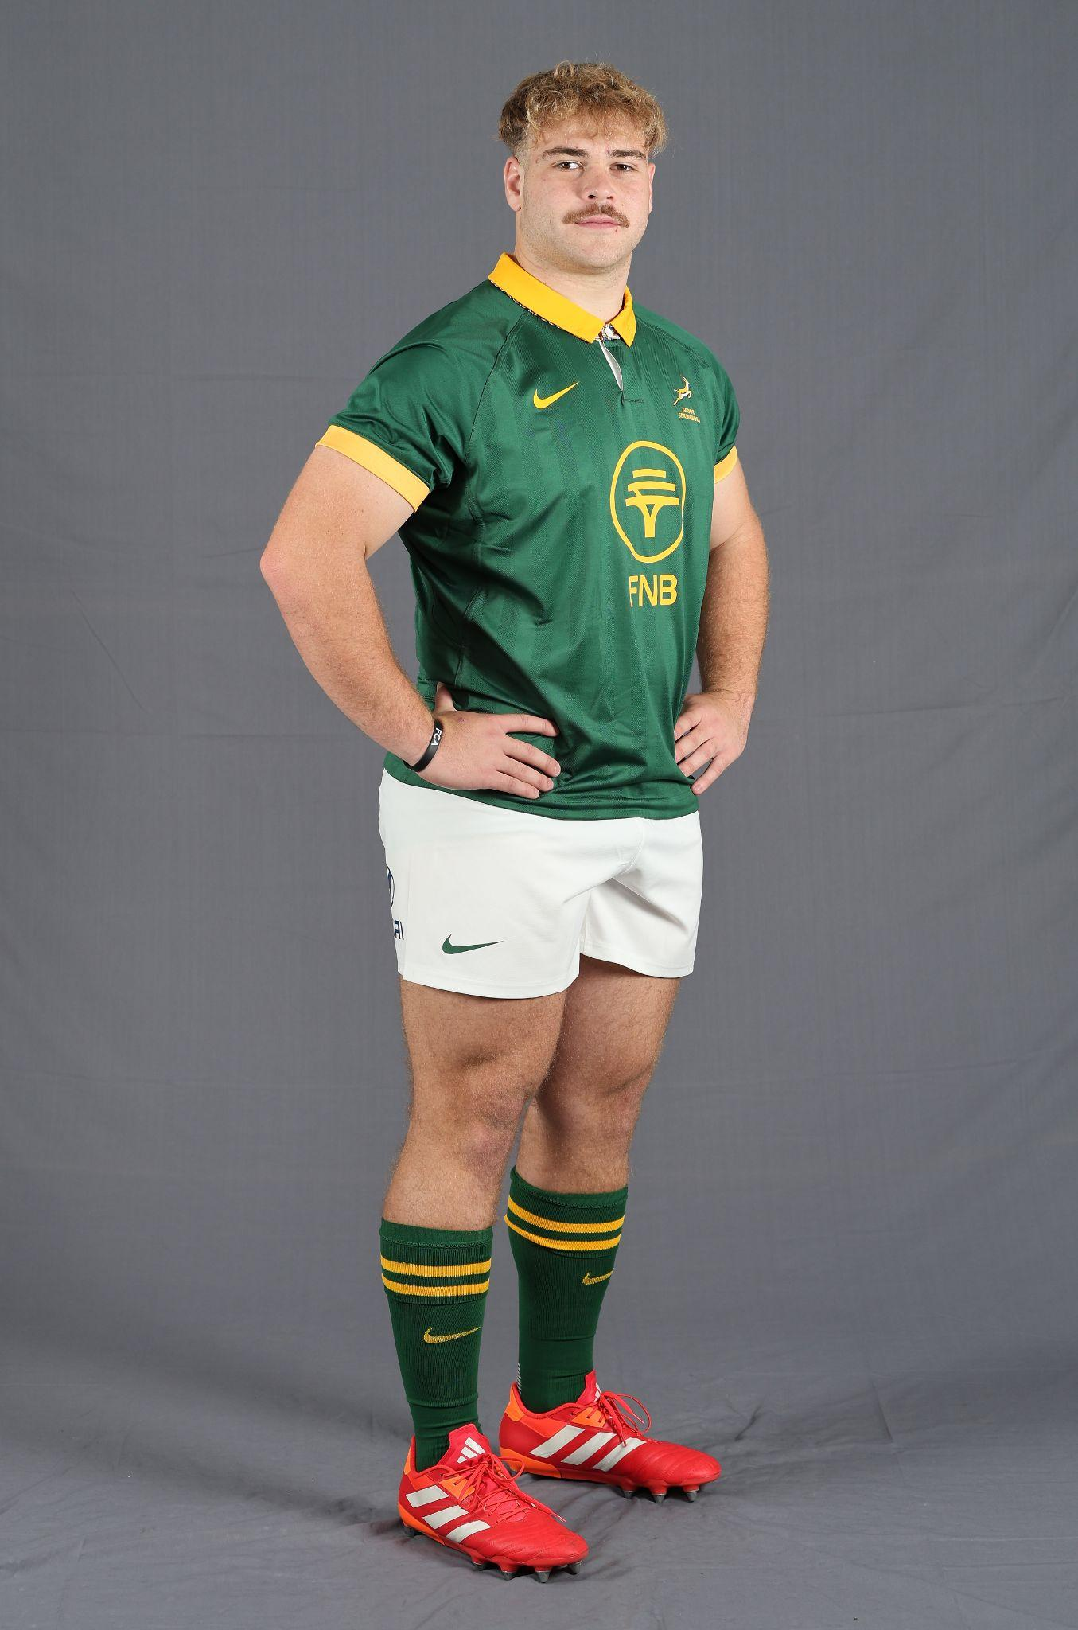
OLIVER
REID
DHL WESTERN PROVINCE
POSITION - PROP
1.85m
HEIGHT
116KG
WEIGHT

Slide 9
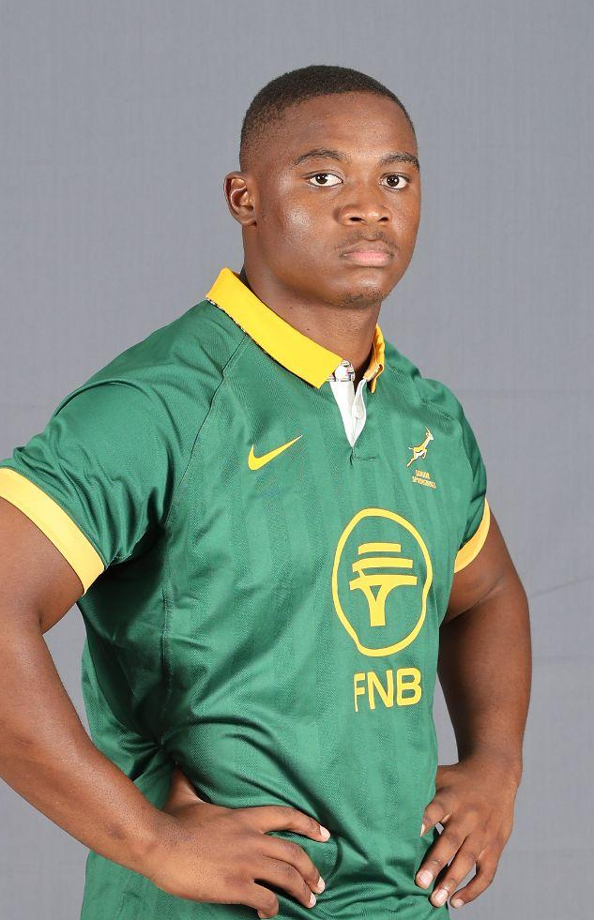
SIPHOSETHU
MNEBELELE
VODACOM BULLS
POSITION - HOOKER
1.83m
HEIGHT
111KG
WEIGHT

Slide 10
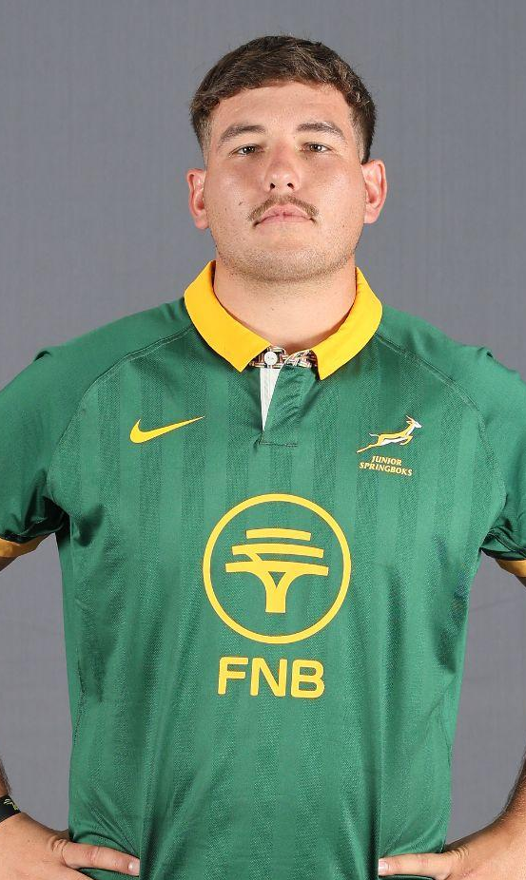
JAUNDRÉ
SCHOEMAN
VODACOM BULLS
POSITION - HOOKER
1.89m
HEIGHT
107KG
WEIGHT

Slide 11

JACO
GROBBELAAR
VODACOM BULLS
POSITION - LOCK
1.98m
HEIGHT
109KG
WEIGHT

Slide 12
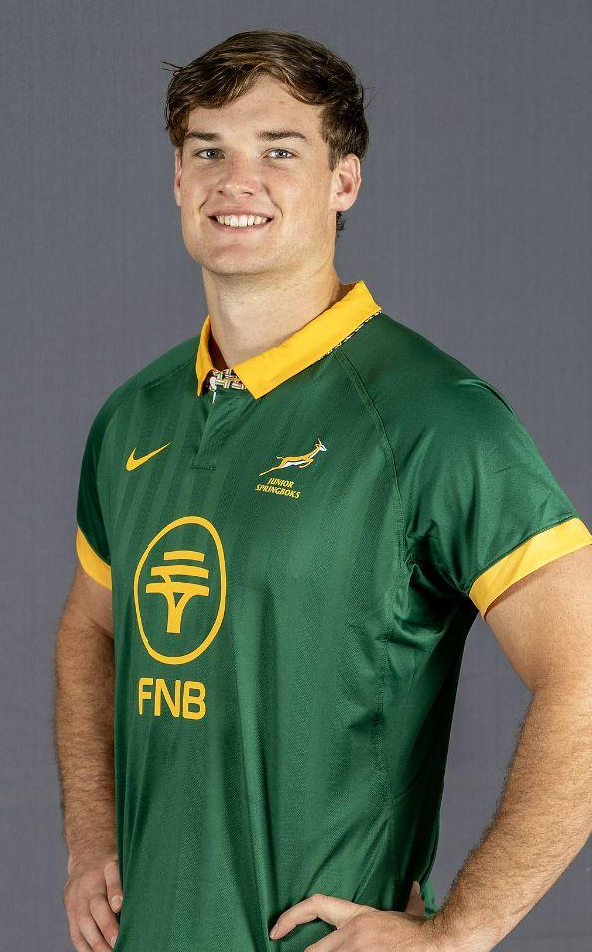
RILEY
NORTON
DHL WESTERN PROVINCE
POSITION - LOCK
CAPTAIN
1.98m
HEIGHT
104KG
WEIGHT

Slide 13
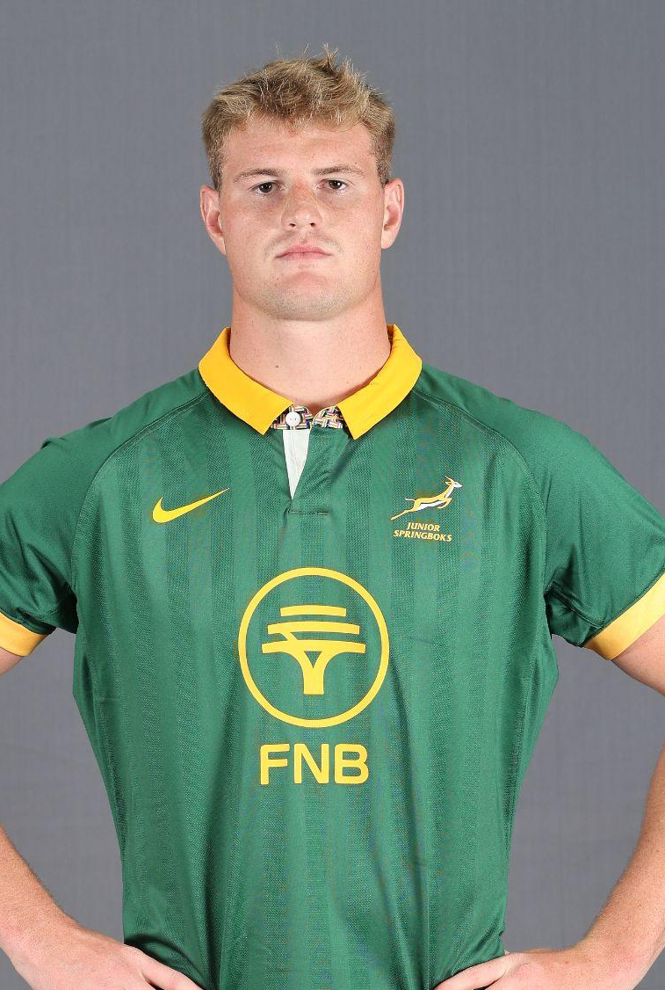
JJ
THERON
VODACOM BULLS
POSITION - LOCK
1.98m
HEIGHT
108KG
WEIGHT

Slide 14
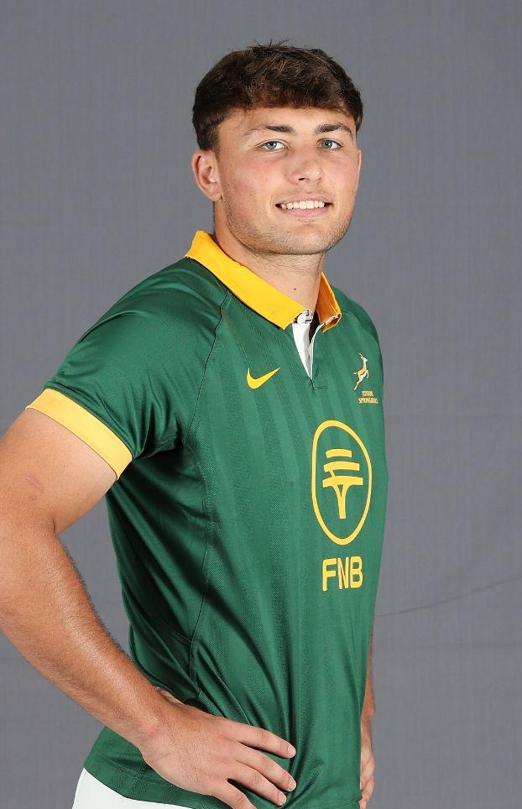
MORNÉ
VENTER
FIDELITY ADT LIONS
POSITION - LOCK
1.97m
HEIGHT
94KG
WEIGHT

Slide 15
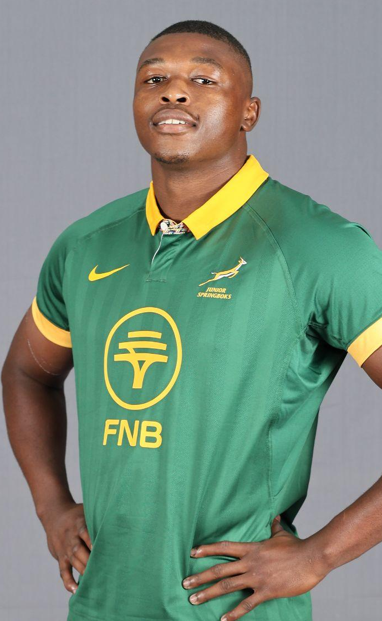
THANDO
BIYELA
FIDELITY ADT LIONS
POSITION - LOOSE FORWARD
1.87m
HEIGHT
93KG
WEIGHT

Slide 16
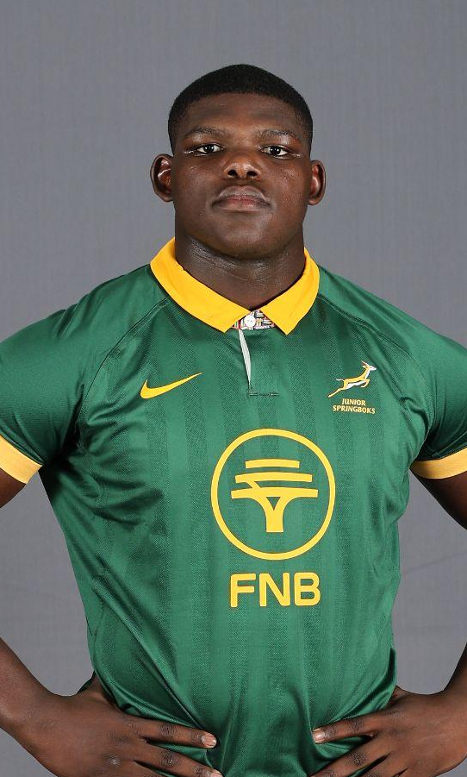
BATHOBELE
HLEKANI
HOLLYWOODBETS SHARKS
POSITION - LOOSE FORWARD
1.88m
HEIGHT
97KG
WEIGHT

Slide 17
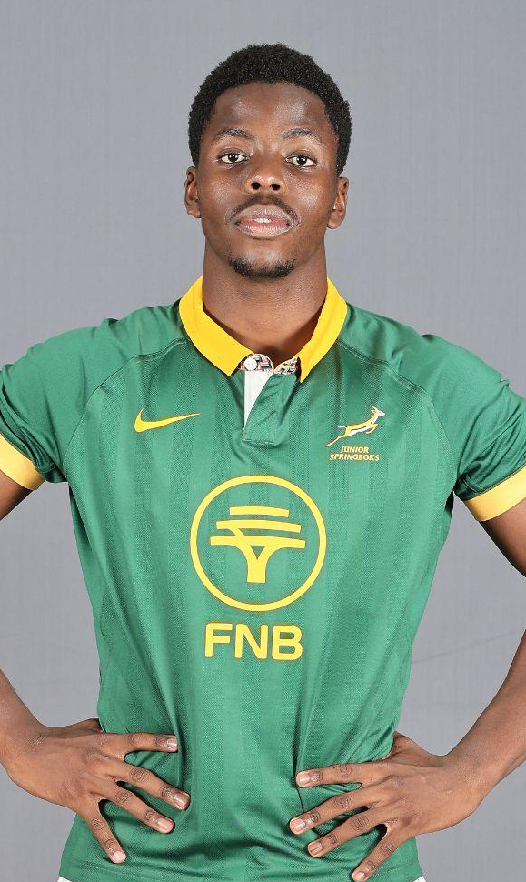
WANDILE
MLABA
DHL WESTERN PROVINCE
POSITION - LOOSE FORWARD
1.91m
HEIGHT
102KG
WEIGHT

Slide 18
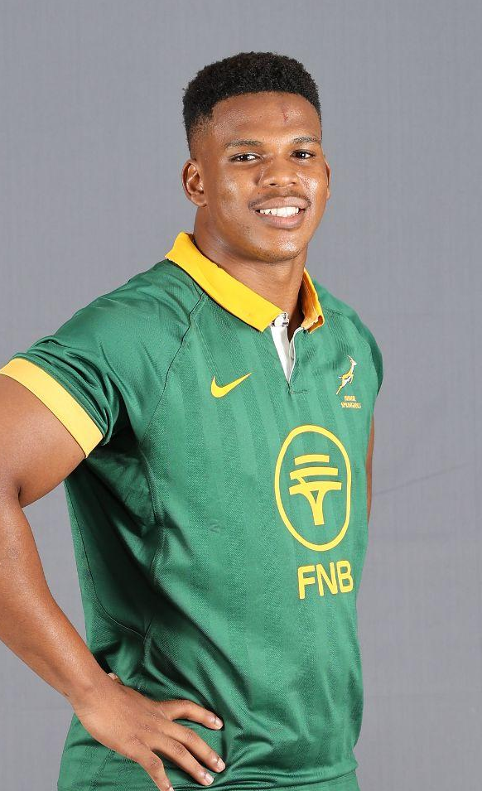
XOLA
NYALI
DHL WESTERN PROVINCE
POSITION - LOOSE FORWARD
1.79m
HEIGHT
91KG
WEIGHT

Slide 19
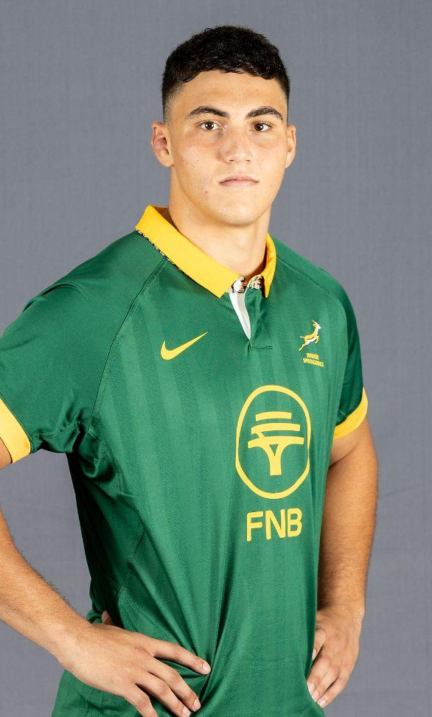
MATT
ROMAO
HOLLYWOODBETS SHARKS
POSITION - LOOSE FORWARD
1.90m
HEIGHT
96KG
WEIGHT

Slide 20
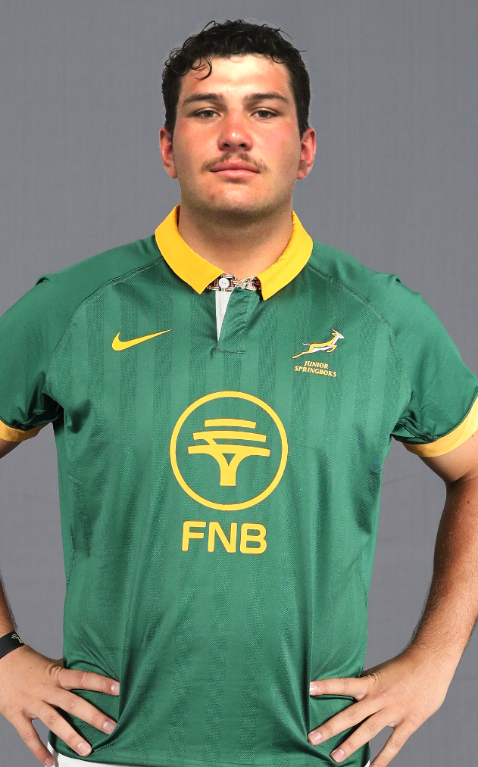
STEPHANUS
LINDE
TOYOTA CHEETAHS
POSITION - LOOSE FORWARD
1.87m
HEIGHT
97KG
WEIGHT

Slide 21
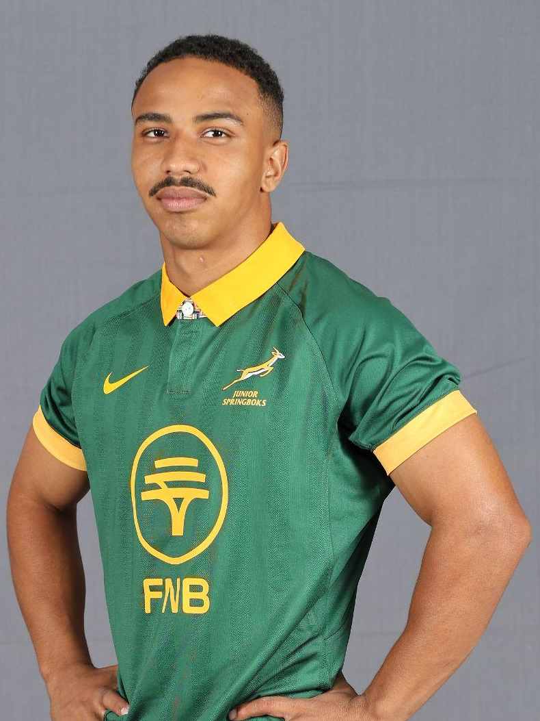
CEANO
EVERSON
HOLLYWOODBETS SHARKS
POSITION - SCRUMHALF
1.65m
HEIGHT
63KG
WEIGHT

Slide 22
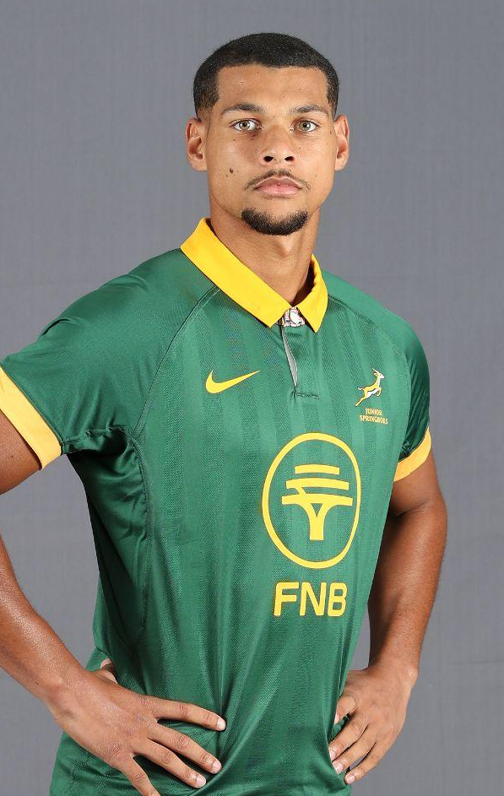
HAASHIM
PEAD
FIDELITY ADT LIONS
POSITION - SCRUMHALF
1.75m
HEIGHT
77KG
WEIGHT

Slide 23
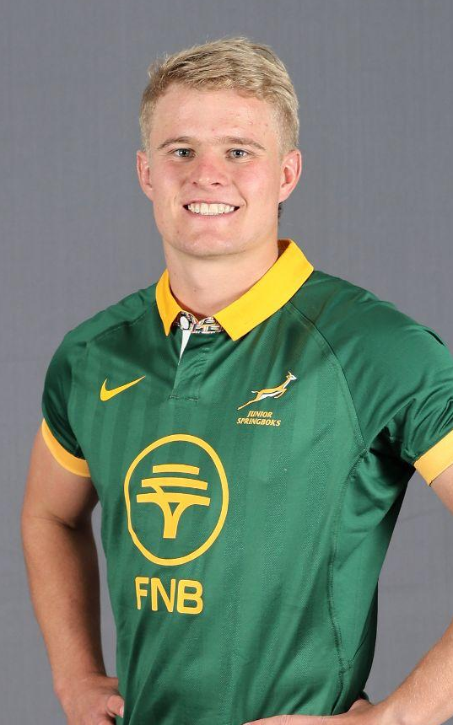
ERICH
VISSER
TOYOTA CHEETAHS
POSITION - SCRUMHALF
1.82m
HEIGHT
82KG
WEIGHT

Slide 24
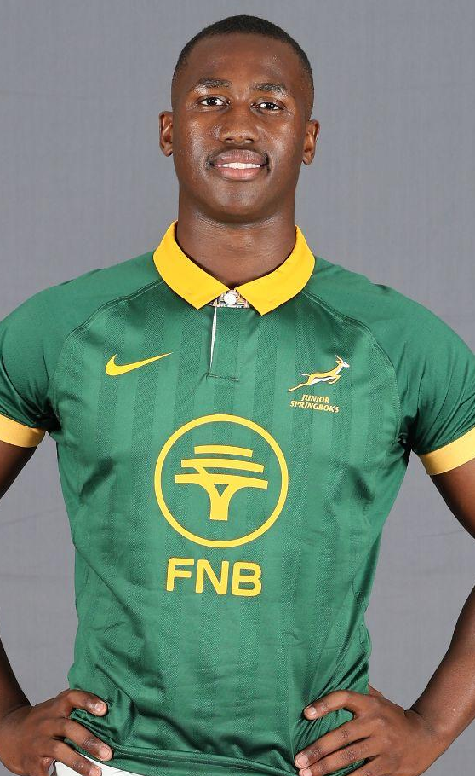
VUSI
MOYO
HOLLYWOODBETS SHARKS
POSITION - FLYHALF
1.82m
HEIGHT
90KG
WEIGHT

Slide 25
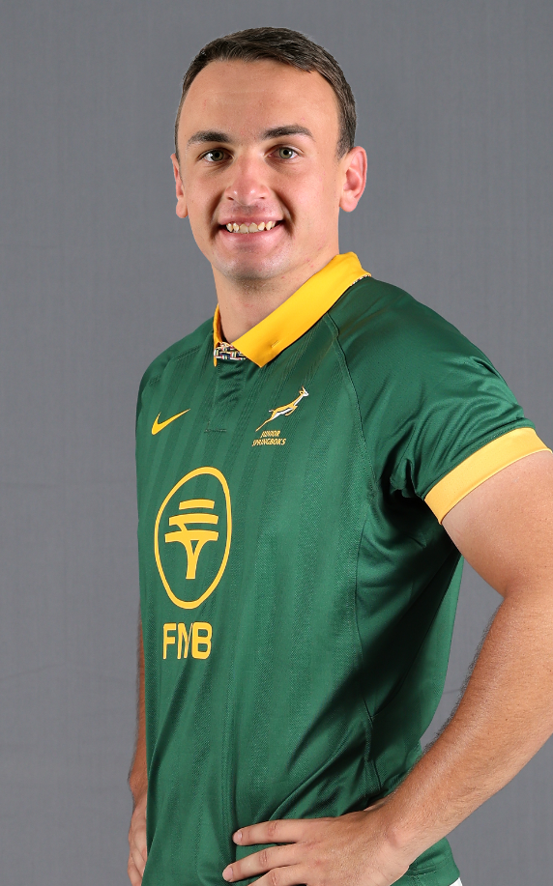
IAN
VAN DER MERWE
VODACOM BULLS
POSITION - FLYHALF
1.90m
HEIGHT
91KG
WEIGHT

Slide 26
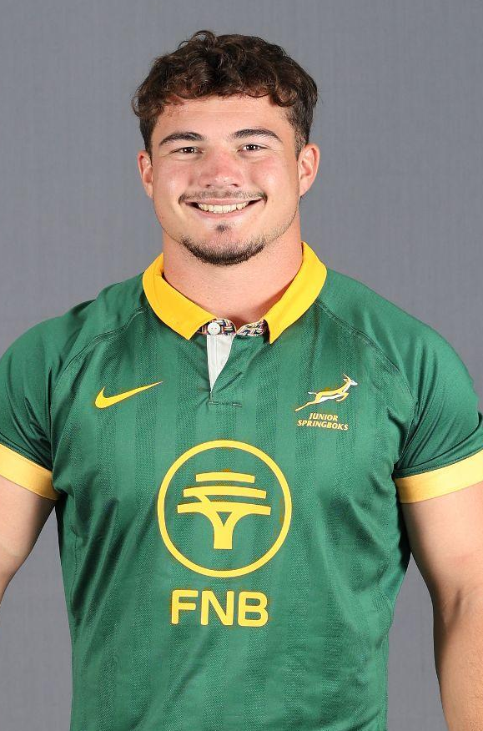
ALBIE
BESTER
HOLLYWOODBETS SHARKS
POSITION - CENTRE
1.80m
HEIGHT
93KG
WEIGHT

Slide 27
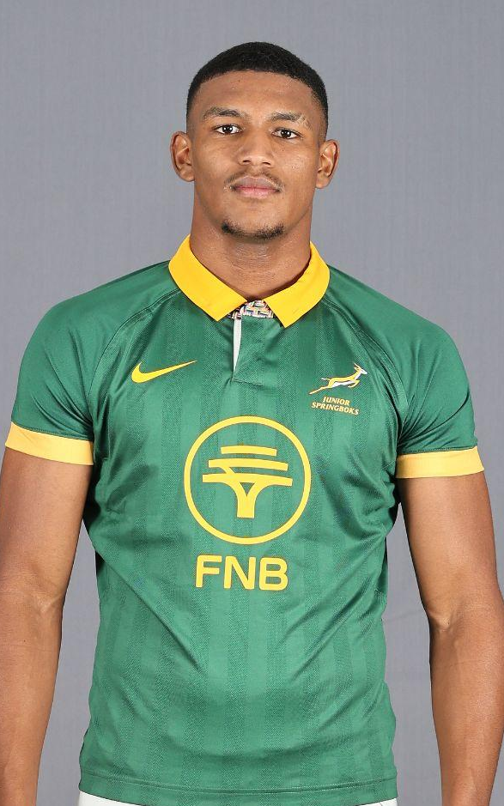
GINO
CUPIDO
DHL WESTERN PROVINCE
POSITION - CENTRE
1.95m
HEIGHT
94KG
WEIGHT

Slide 28
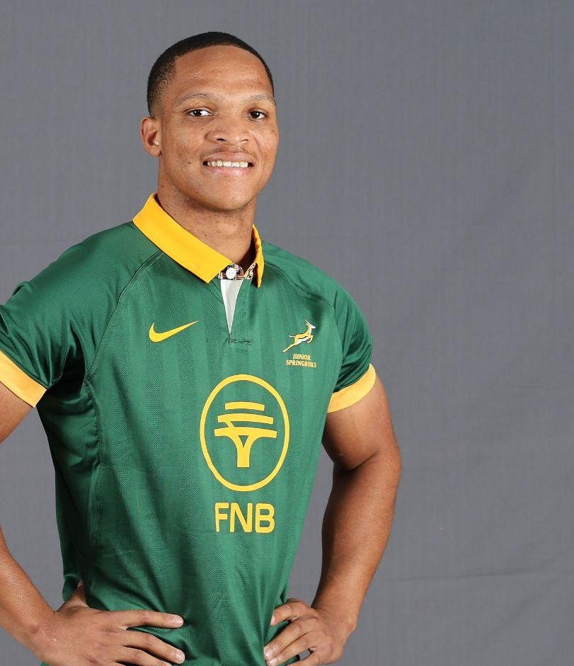
DEMITRE
ERASMUS
VODACOM BULLS
POSITION - CENTRE
1.78m
HEIGHT
83KG
WEIGHT

Slide 29
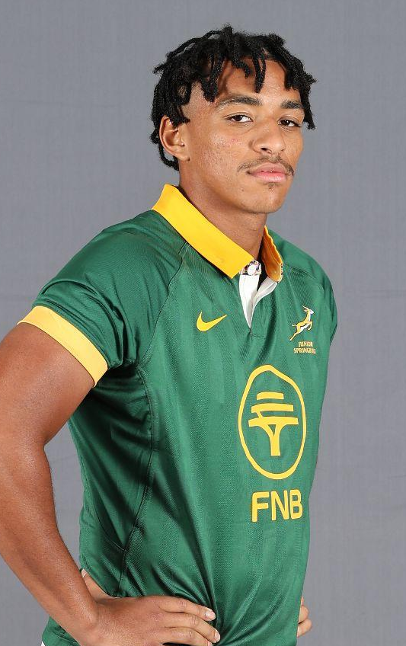
DOMINIC
MALGAS
DHL WESTERN PROVINCE
POSITION - CENTRE
1.87m
HEIGHT
86KG
WEIGHT

Slide 30
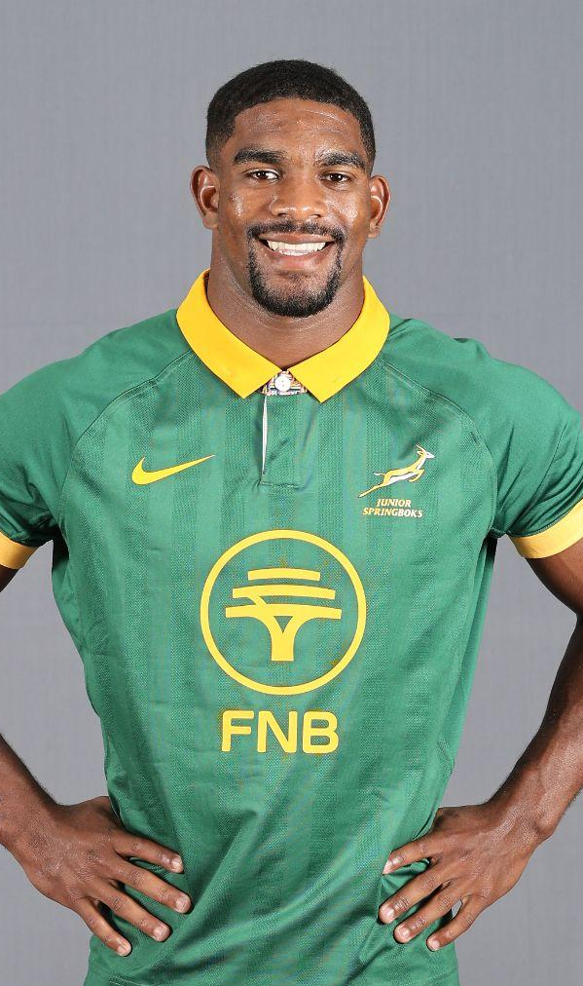
CHESWILL
JOOSTE
VODACOM BULLS
POSITION - OUTSIDE BACK
1.75m
HEIGHT
72KG
WEIGHT

Slide 31
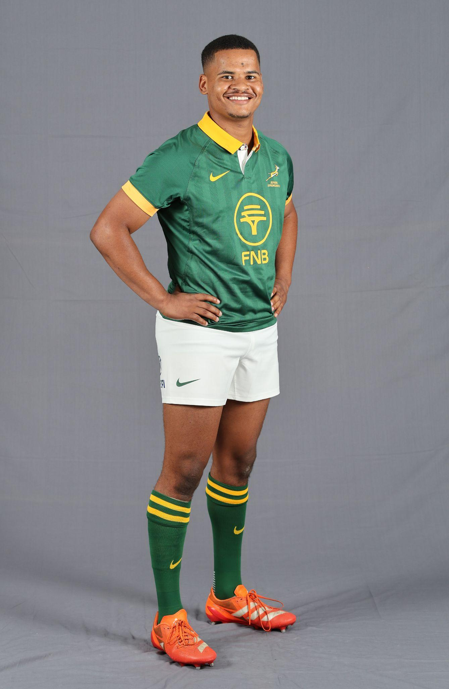
GILERMO
MENTOE
FIDELITY ADT LIONS
POSITION - OUTSIDE BACK
1.76m
HEIGHT
72KG
WEIGHT

Slide 32
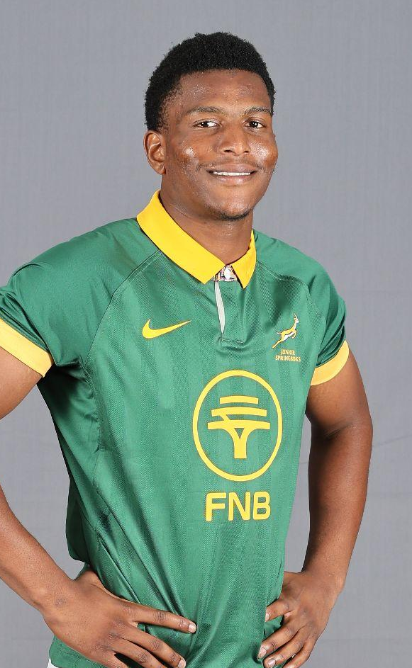
SIYA
NDLOZI
DHL WESTERN PROVINCE
POSITION - OUTSIDE BACK
1.83m
HEIGHT
81KG
WEIGHT

Slide 33
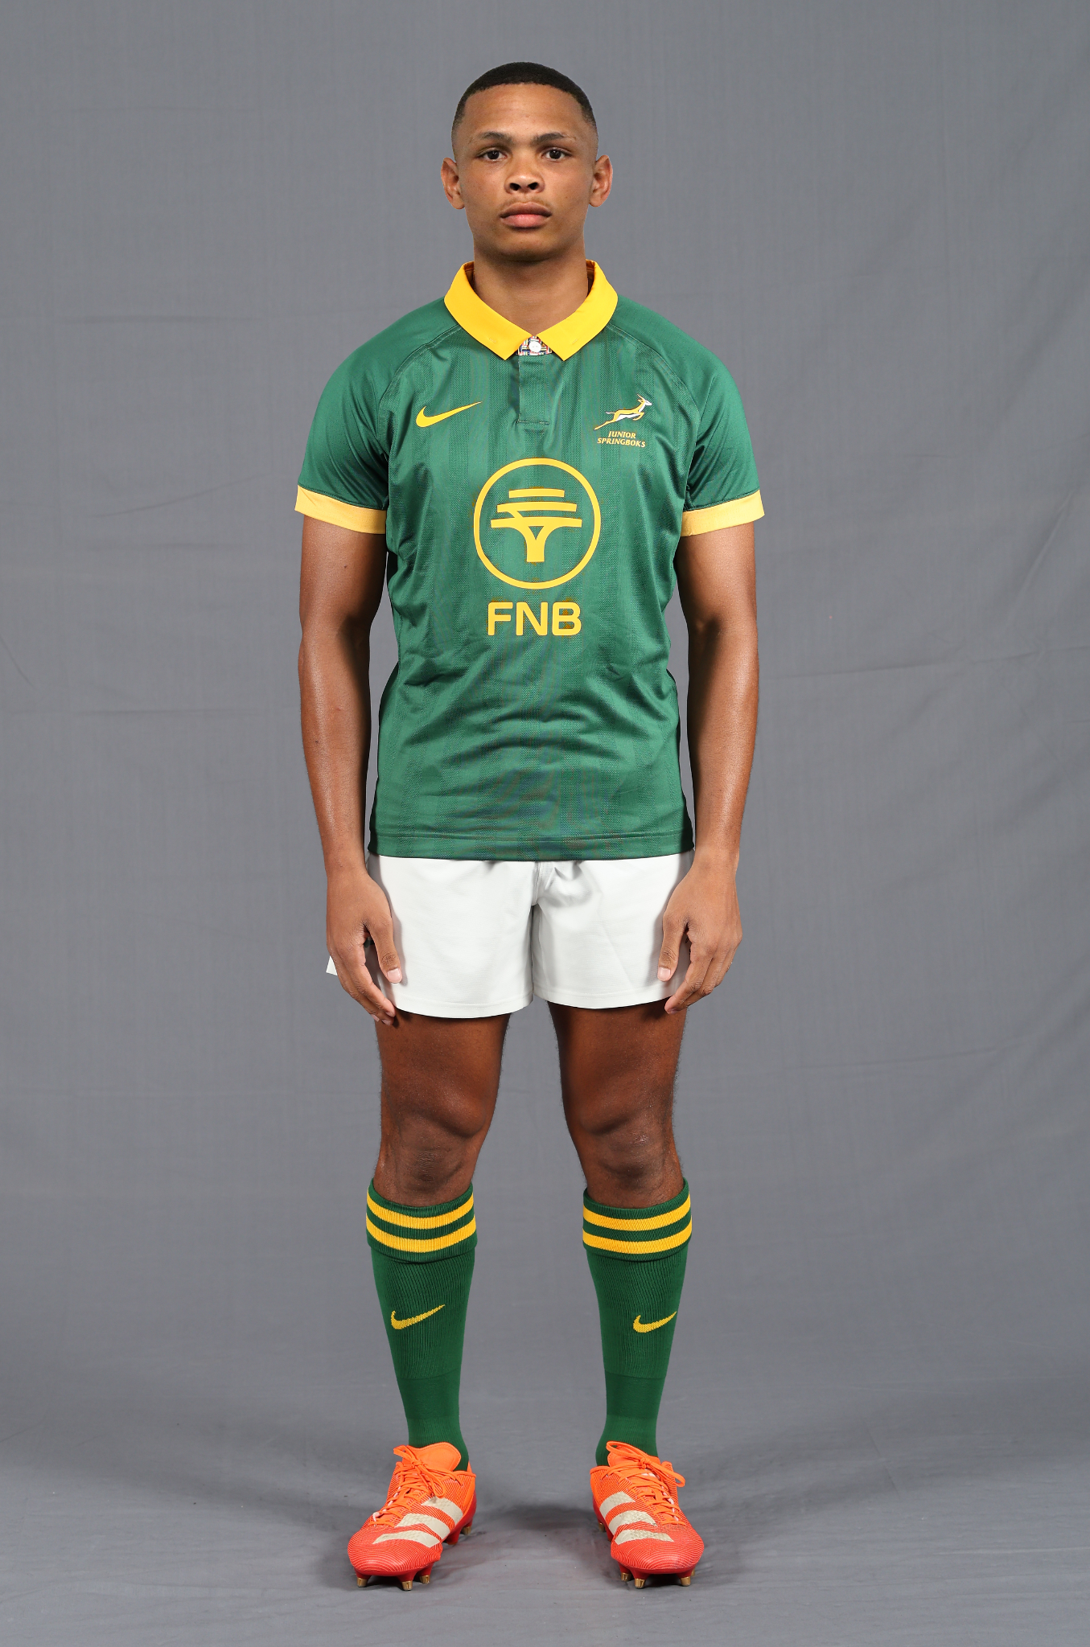
JACO
WILLIAMS
HOLLYWOODBETS SHARKS
POSITION - OUTSIDE BACK
1.75m
HEIGHT
72KG
WEIGHT

Slide 34
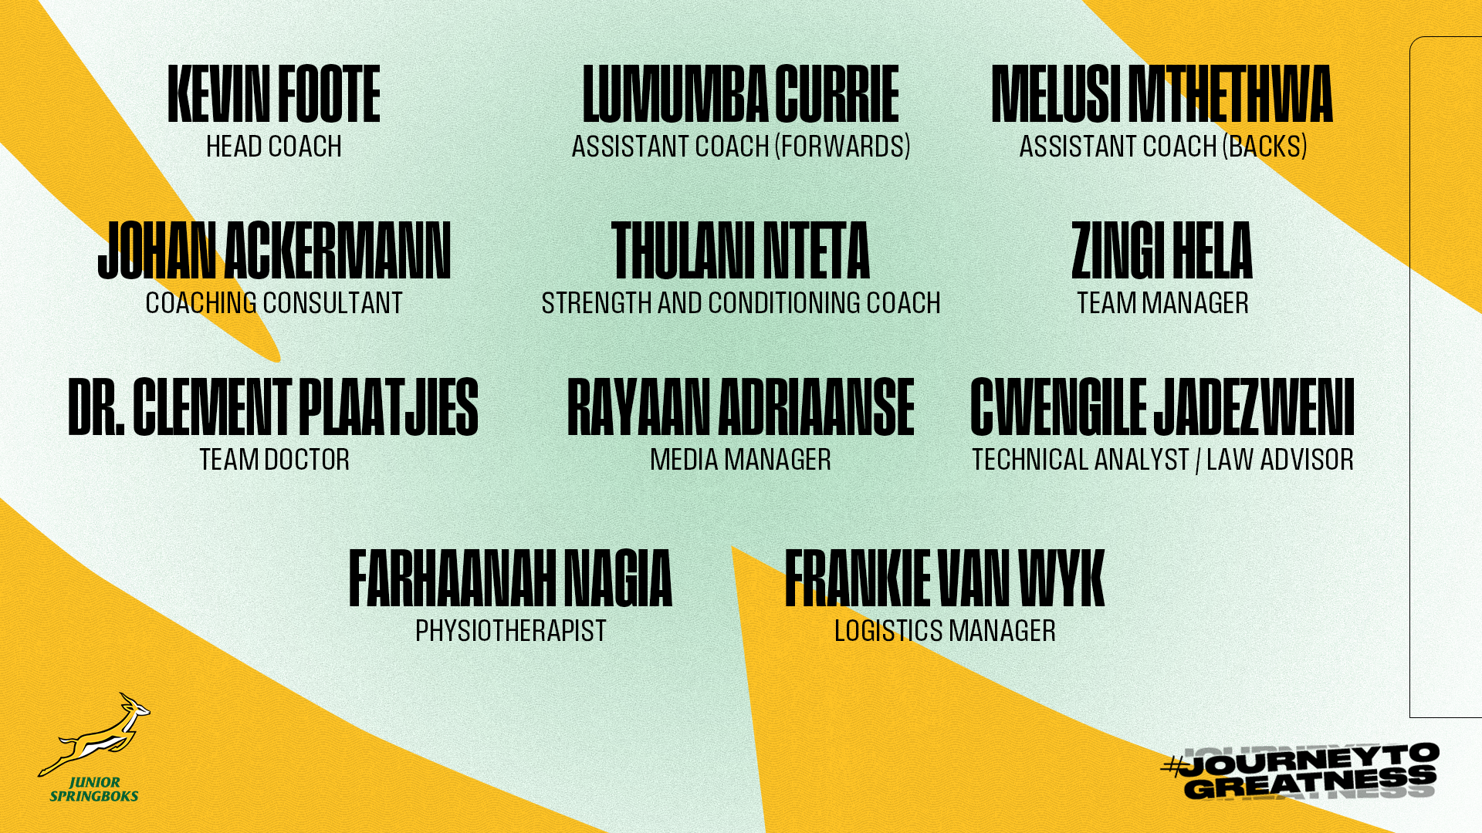

Slide 35
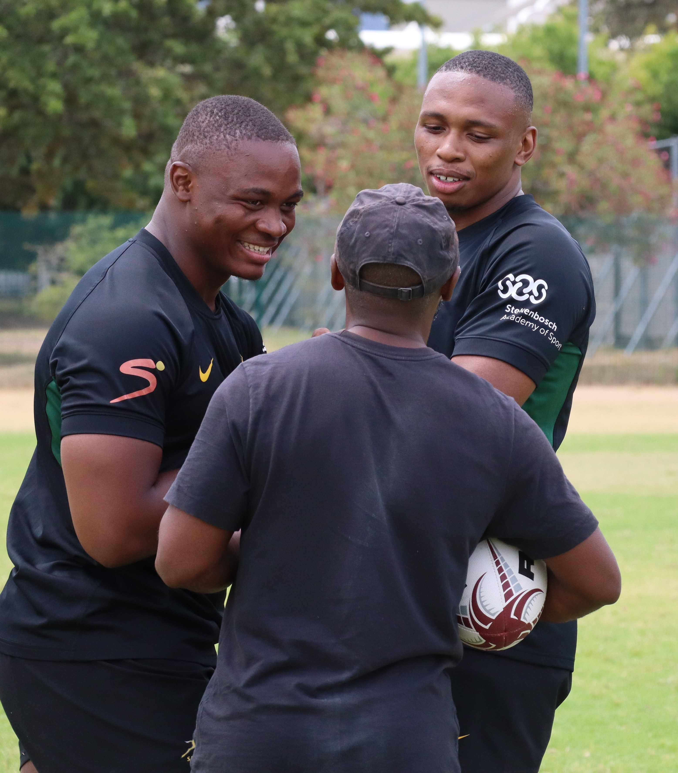




Media Contact
– Rayaan Adriaanse –
rayaan@sarugby.co.za
WhatsApp
+27 82 999 0022
www.sarugby.co.za

Slide 36


